Slide 1
Network Infrastructure DCS4203
Lecturer name: Mrs. Simon loh Khang liang
Student name : lee Zhan Wei
Student id:DCS2304084

Slide 2
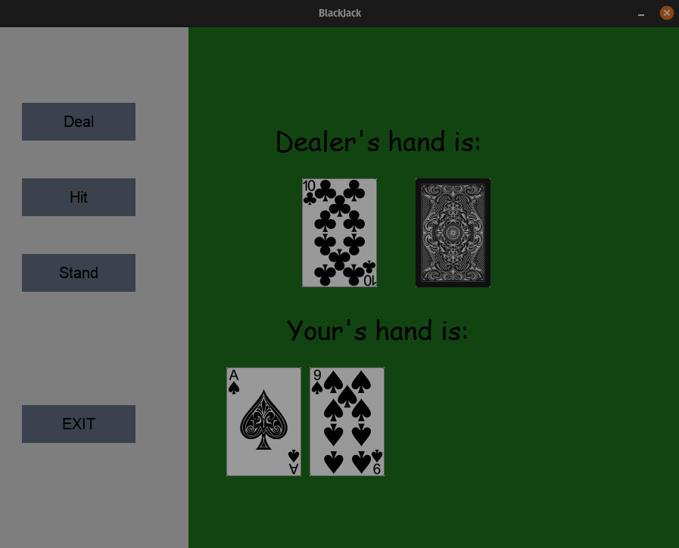
Telnet Blackjack Game
A simple classic blackjack game using telnet

Slide 3

Introduction to Telnet Blackjack Game
My Blackjack House rules
There are no joker cards in deck.
The Jack/Queen/King are all counted as 10.
The Ace card can count as either 11 or 1.
Cards are not removed from the deck as they are drawn.
The computer is the dealer.

Slide 4
Use the following list as the deck of cards
Deck of cards:
Cards= 【 Ace(1/11), 2, 3, 4, 5, 6 , 7, 8, 9, Jack(10), Queen (10), King (10) 】

Slide 5
COC (Code of Coding)
COC OVERVIEW OF BLACKJACK IN PYTHON USING TELNET
Initialization
Client Handling
Game initialization
Display Header
Main Game Loop
Player Action
Post-Round Display
Round Result
Play Agian

Slide 6
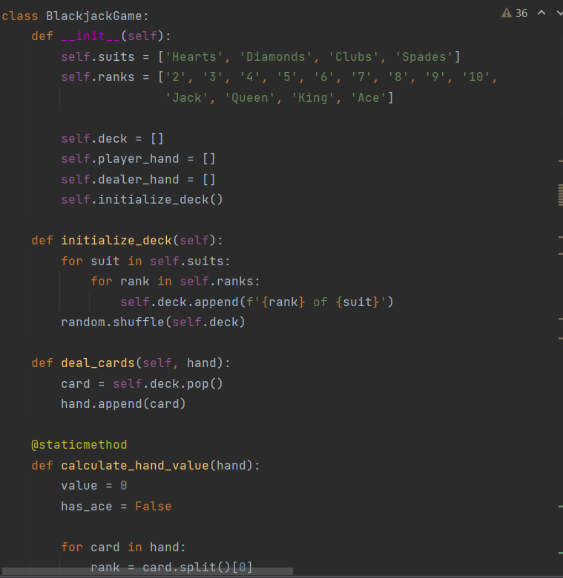
Initialization of Blackjack Game
Initializes a new Blackjack game.
Listens for incoming connections from clients.
__init__ method
Purpose: Initializes a new instance of the Blackjack game class.
Attributes
Suits: A list containing the four suits in a standard deck.
Ranks: A list containing the ranks for each card in a standard deck.
Deck: An empty list to store the deck of cards.
Player hand: An empty list to represent the player’s hand. dealer hand: An empty list to represent the dealer’s hand.
Initialize deck: Initializes and shuffles the deck of cards in way random

Slide 7
Deal_Cards
Purpose: Deal a card from the deck to a specified hand (player or dealer’s hand).
Calculate hand value
Purpose: Calculate the value of a hand in Blackjack.
Process: pops a card from the deck and appends the cards to the specified hand.
Process :
Iterates through each card in the hand.
Checks the rank of the card and adds the corresponding value.
Adjust the Ace card if needed to avoid from busting.

Slide 8
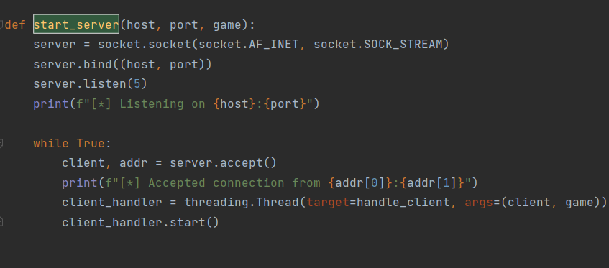
Client Handling
Accept a new client connection.
Creates a new threading “Client Header” to handle the client separately.
Starts a client handler thread.
Start server
Socket Initialization server= socket.socket(socket.AF_INET, socket.SOCK_STREAM): Creates a new socket using IPv4 and TCP
Binding and Listening server. Bind((host, port)): Binds the server socket to the specified host and port. server. Listen(5): Listens for incoming connections with a maximum backlog of 5.
Server Loop: while True: Initiates an infinite loop for continuously accepting client connections. client, addr = server. Accept(): Accepts a new client connection and retrieves the client socket and address. print(f"[*] Accepted connection from {addr[0]}:{addr[1]}"): Prints a message indicating that a connection has been accepted. client_handler = threading.Thread(target=handle_client, args=(client, game)): Creates a new thread (client_handler) that will handle the client connection using the handle_client function. client_handler.start(): Starts the client handling thread.

Slide 9
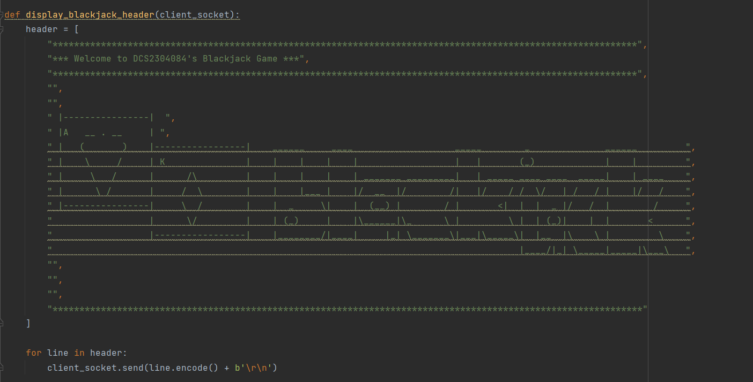
Display Header
The display_blackjack_header function is called to send a header to the client that displaying a welcome message.
Each line is encoded as bytes and followed by a newline character (\r\n) that margined to next line and issued beginning of the line(left).

Slide 10
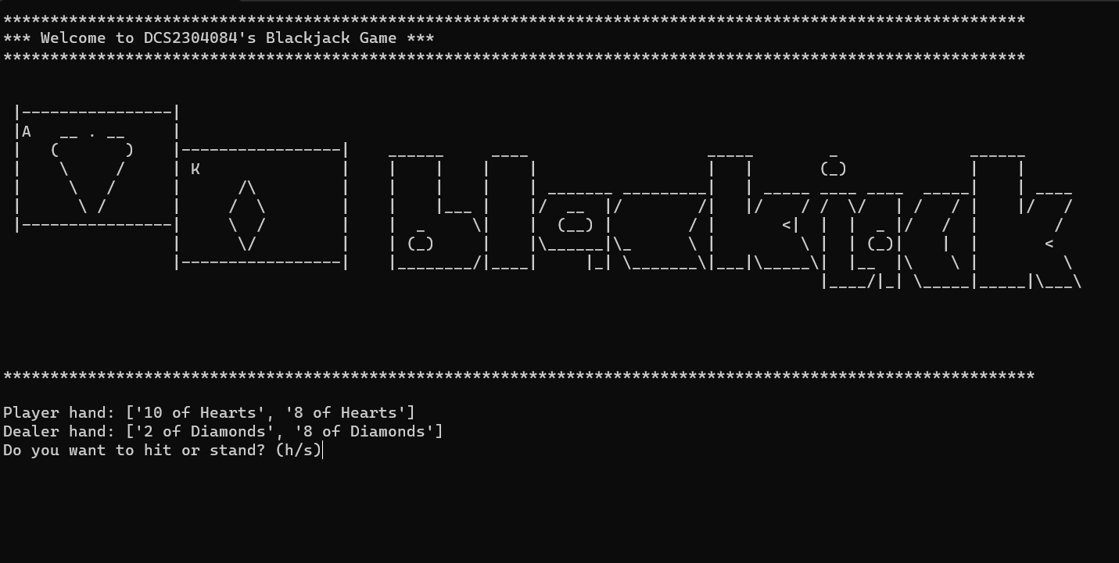
Main Game Loop

Slide 11
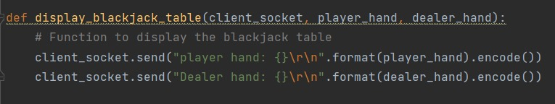
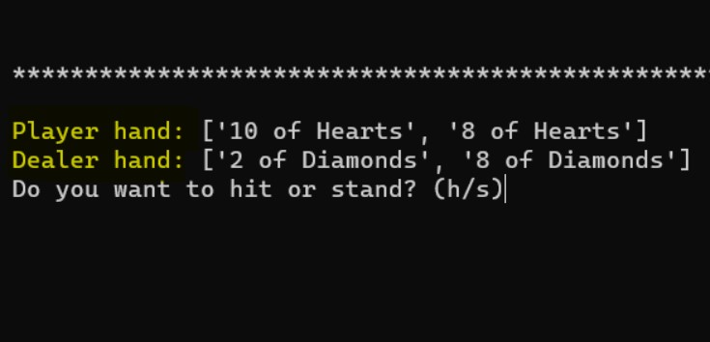
Display Blackjack Table
The purpose of the function method is to keep the player informed about the current state of the game By sending the hands of both the player and the dealer to the client's interface so that the player would be prompted to take further action.
Real-time Updates. These updates take places in the main game loop continuously
Where player can see how the game is progressing Including cards being dealt and actions being taken.
client_socket.send Dealer hand:{}\r\n".format(dealer_hand).encode() player hand:{}\r\n".format(player_hand).encode()
Sends the dealer's hand to the client's socket

Slide 12
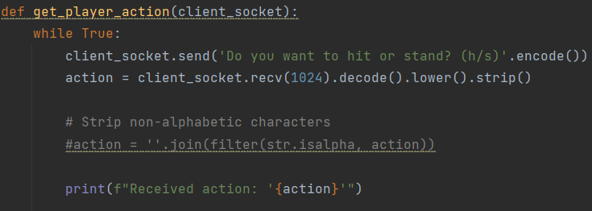
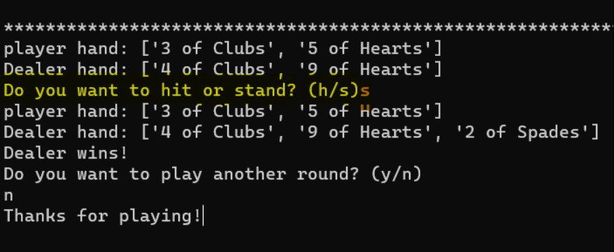
Player Action
The purpose of the function method is to ensure the player’s input is valid provides a structed flow for continuing or ending the game based on the player’ choices.
Sending Player’s Action client_socket.send('Do you want to hit or stand? (h/s)'.encode()) Sends a prompt to the client, asking whether the player wants to hit or stand. The options are encoded and sent as bytes.
Receiving Player’s Action action = client_socket.recv(1024).decode().lower().strip() Receives the player's action from the client, converts it to lowercase, and removes leading/trailing whitespace.

Slide 13
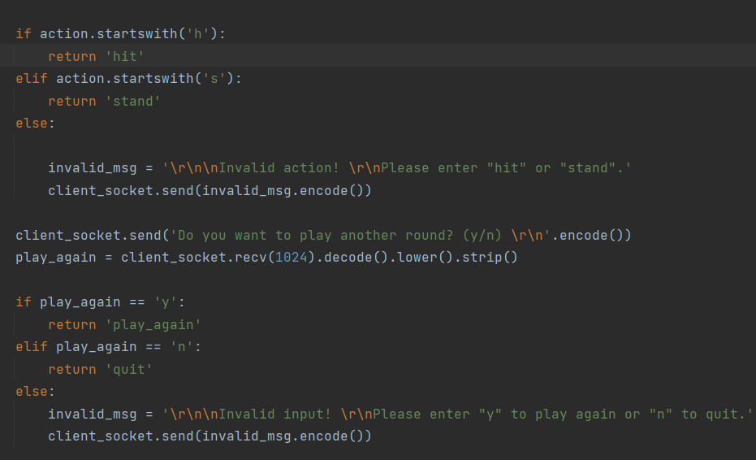
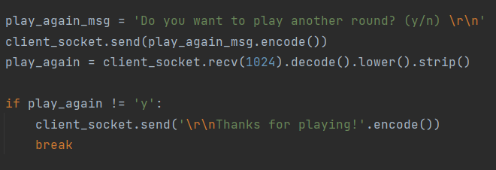
Player Action
Handling Play Again Prompt if the action starts with ‘h’, it returns ‘hit’ ; if the action starts with ‘s’, it returns ‘stand’ ; if the action is invalid, it sends an invalid message to the client.
Handling Play Again Prompt After handling the action, it prompts the player with ‘Do you want to play another round? (y/n) With\r\n’. After input y, the next prompt will start in the beginning of the next line that showing ‘Thanks for playing!‘.

Slide 14
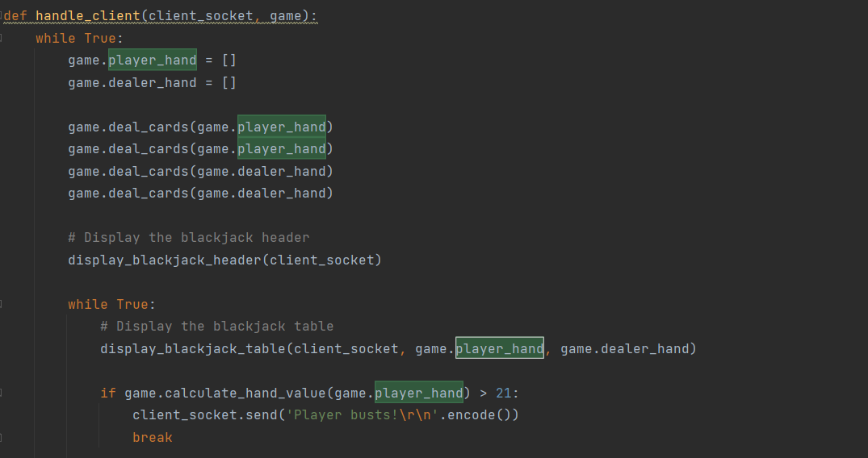
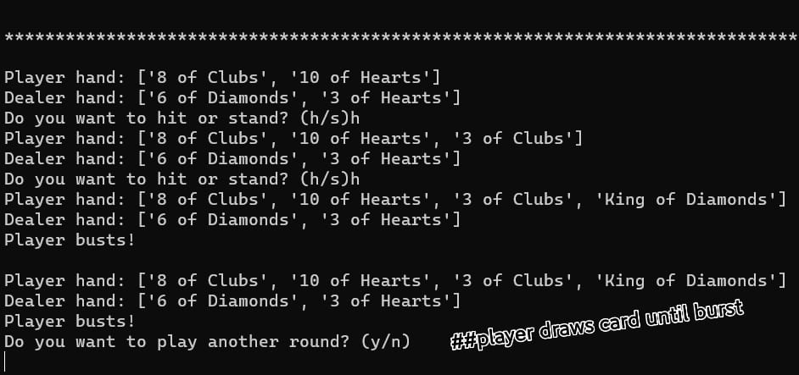
Handle Client
Round result if the player busts, a message is sent to the client; if the dealer busts, a message is sent to the client that indicating that the player wins, ; Somehow the dealer is the last to draw a card, but the dealer standing a absolute advantage of only displaying the results of the round if the player chooses to "hit" until card value burst by above 21 or “stand“ not to draw.
Play Again The client is asked if they want to play another round. If the response is not ‘y’, the client loop break then the connection is closed. With\r\n’. After input y, the next prompt will start in the beginning of the next line that showing ‘Thanks for playing!‘.

Slide 15
Demonstration session

